Slide 1
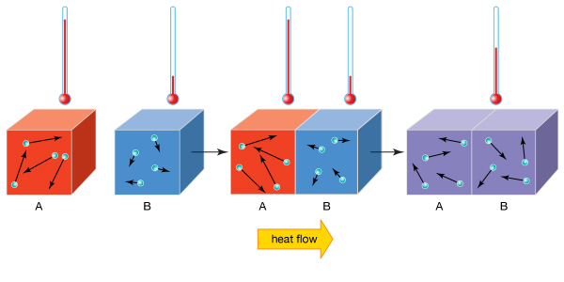
Daily Review
Thermal Equilibrium
Thermal energy will transfer from an object at a higher temperature to one at a lower temperature.
When both objects will reach the same temperature, the transfer of energy stops.
In your own words, describe what is meant by thermal equilibrium.

Slide 2
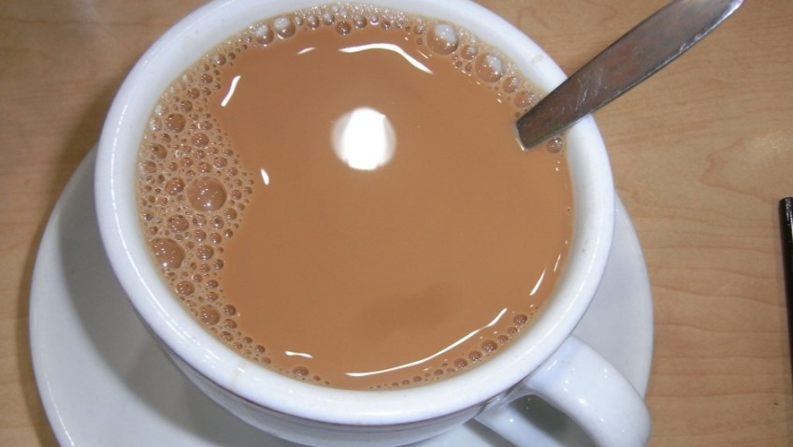
Daily Review
Describing Heat Transfer
Identify the object with higher thermal energy. State the direction of energy transfer. Describe what will happen to the temperature of the objects.
You make a cup of tea and leave the spoon in the cup.
The _____ has higher thermal energy and will transfer heat to ____________. The ________ gains heat from the _______ until they are the same temperature.

Slide 3
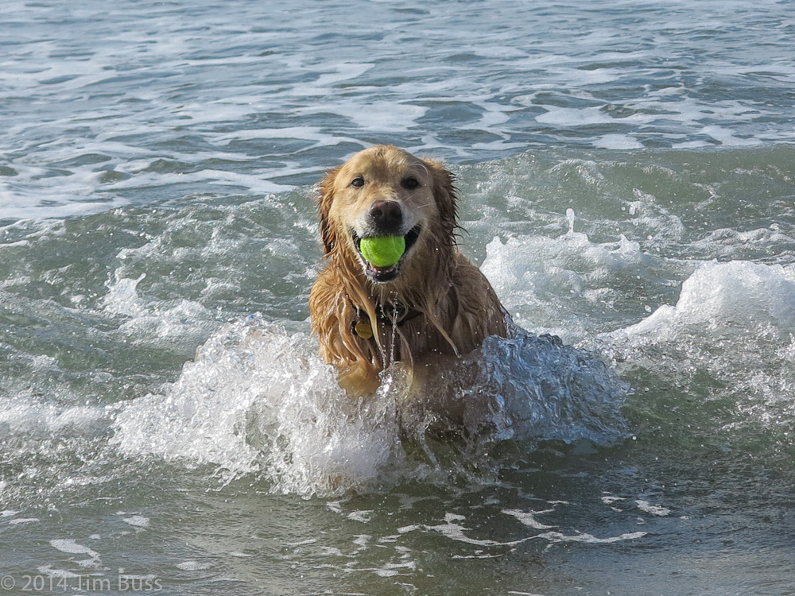
Daily Review
Describing Heat Transfer
Identify the object with higher thermal energy. State the direction of energy transfer. Describe what will happen to the temperature of the objects.
On a hot day you go swimming at the beach.
The _____ has higher thermal energy and will transfer heat to ____________. The ________ gains heat from the _______ until they are the same temperature.

Slide 4
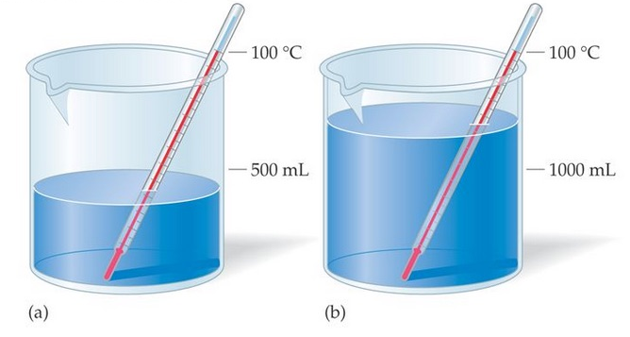
Skill Development/Guided Practice
Comparing Thermal Energy
Identify whether the temperature or the volume of the objects is the same. Same temperature = larger object has more thermal energy Same volume = hotter object has more thermal energy Explain why the object has more thermal energy
The objects are the same ________. The __________ has more thermal energy because _________________.

Slide 5
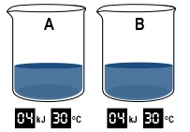
Skill Development/Guided Practice
Comparing Thermal Energy
Identify whether the temperature or the volume of the objects is the same. Same temperature = larger object has more thermal energy Same volume = hotter object has more thermal energy Explain why the object has more thermal energy
The objects are the same ________. The __________ has more thermal energy because _________________.

Slide 6
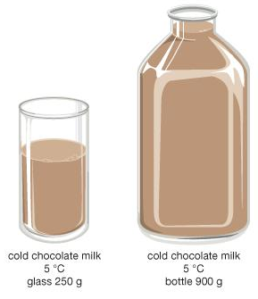
Skill Development/Guided Practice
Comparing Thermal Energy
Identify whether the temperature or the volume of the objects is the same. Same temperature = larger object has more thermal energy Same volume = hotter object has more thermal energy Explain why the object has more thermal energy
The objects are the same ________. The __________ has more thermal energy because _________________.

Slide 7
Methods of Thermal Energy Transfer

Slide 8
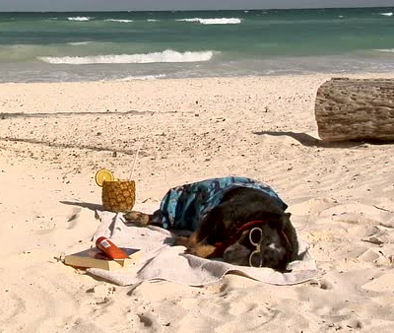
Learning Objectives
CFU
What are we going to learn?
Identify and describe the three methods through which thermal energy is transferred.
Activate Prior Knowledge
Think, Pair, Share: What happens to your body temperature when you lie on a towel in the Sun at the beach?

Slide 9
Concept Development
CFU 1
Which way is heat transferred?
Thermal Energy Transfer
Thermal energy is transferred from hot objects to colder objects.
The energy transfer continues until the objects reach thermal equilibrium.
CFU 2
In your own words, describe thermal equilibrium.

Slide 10
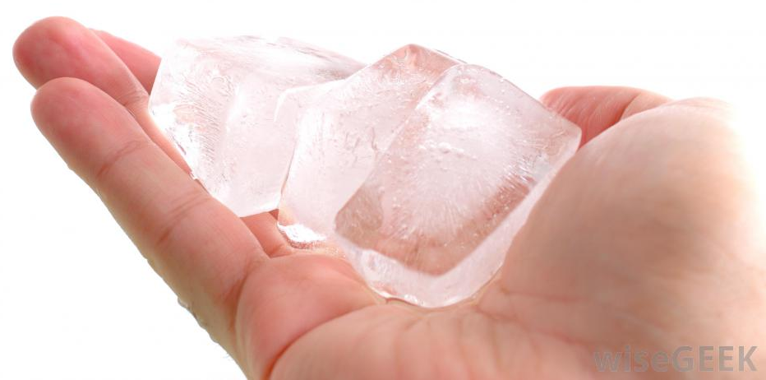
Concept Development
CFU 1
Which way is heat transferred between two objects?
Thermal Energy Transfer: Conduction
Thermal energy is transferred from hot to cold objects.
When two objects are in direct contact, thermal energy is transferred through conduction.
CFU 2
When is heat transferred by conduction?

Slide 11
Concept Development
CFU 2
Which way is heat transferred in this situation?
Thermal Energy Transfer: Conduction
Consider what happens when an ice cube sits in your hand:
The particles in your hand are at a higher temperature, so they have more kinetic energy and vibrate faster.
The quickly vibrating particles in your hand bump into the slower moving particles in the ice cube.
When the particles collide, energy transfers from your hand to the ice cube, causing it to warm up.
CFU 3
How does thermal energy move from your hand to the ice cube?
CFU 4
Describe what happens when you stand barefoot on hot ground.

Slide 12
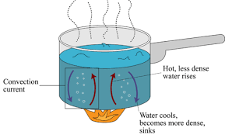
Concept Development
CFU 1
When is thermal energy transferred by convection?
Thermal Energy Transfer: Convection
Thermal energy moves by convection in liquids and gases.
Convection currents carry thermal energy through liquids and gases as the particles move.

Slide 13
Concept Development
CFU 1
How does thermal energy transfer from pan to water?
Thermal Energy Transfer: Convection
Consider what happens when water is heated in a saucepan:
Thermal energy is transferred from the saucepan to the water through conduction.
The water particles in contact with the metal heat up and the liquid becomes less dense.
The heated particles begin to rise, and cooler ones take their place.
The heated water particles take thermal energy with them as they move.
CFU 2
Describe how thermal energy moves within a liquid.
CFU 3
Think, Pair, Share: Name another situation where thermal energy is transferred by convection.

Slide 14
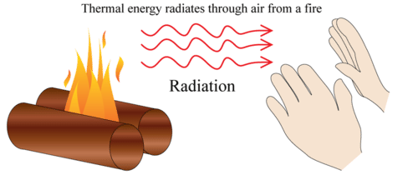
Concept Development
CFU 1
What is radiation?
Thermal Energy Transfer: Radiation
Radiation is the transfer of energy across space or through another substance without heating it.
All objects emit radiation – the hotter an object is, the more radiation it gives off.
Radiation can be in many forms including visible light, microwaves or infrared radiation, which we sense as heat.
CFU 2
How is temperature related to the amount of radiation?

Slide 15
Concept Development
CFU 1
How is temperature related to the amount of radiation?
Thermal Energy Transfer: Radiation
Consider what happens when an object is placed in front of a campfire:
The fire emits thermal energy as infrared radiation.
The thermal energy travels through the air without heating the air.
The object absorbs the thermal energy and increases in temperature.
CFU 2
Describe how thermal energy is transferred by radiation.
CFU 3
Think, Pair, Share: Name another situation where thermal energy is transferred by radiation.

Slide 16
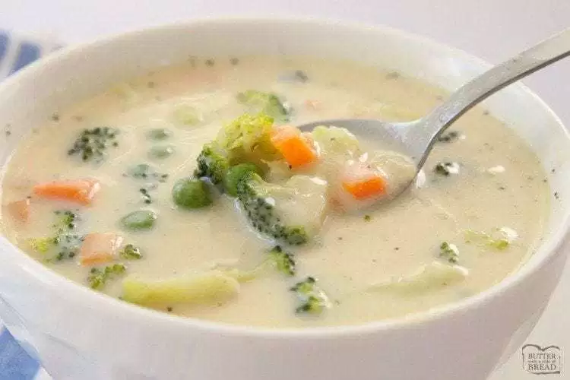
Skill Development/Guided Practice
Reminder: Thermal Energy Transfer Methods
Conduction – Energy transfer between two objects are in direct contact Convection – Energy transfer through movement of particles in liquids and gases Radiation – Energy transfer through space or other substances without it being heated
Describing Methods of Thermal Energy Transfer
Identify the type of energy transfer: Conduction/Convection/Radiation Explain why it is that type of energy transfer
A spoon warms up when it is put into soup.
The thermal energy is transferred from the soup to the spoon through conduction because the two objects are in direct contact.

Slide 17
Skill Development/Guided Practice
Reminder: Thermal Energy Transfer Methods
Conduction – Energy transfer between two objects are in direct contact Convection – Energy transfer through movement of particles in liquids and gases Radiation – Energy transfer through space or other substances without it being heated
Describing Methods of Thermal Energy Transfer
Identify the type of energy transfer: Conduction/Convection/Radiation Explain why it is that type of energy transfer
Your body warms up when you lie in the Sun.
The thermal energy is transferred from the Sun to your body through radiation because the energy is being transferred through space.

Slide 18
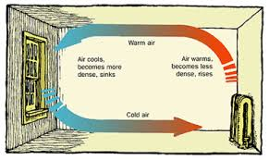
Skill Development/Guided Practice
Reminder: Thermal Energy Transfer Methods
Conduction – Energy transfer between two objects are in direct contact Convection – Energy transfer through movement of particles in liquids and gases Radiation – Energy transfer through space or other substances without it being heated
Describing Methods of Thermal Energy Transfer
Identify the type of energy transfer: Conduction/Convection/Radiation Explain why it is that type of energy transfer
A heater warming up a room.
The thermal energy is transferred around the room through convection because the energy is being transferred by moving particles in a gas.

Slide 19
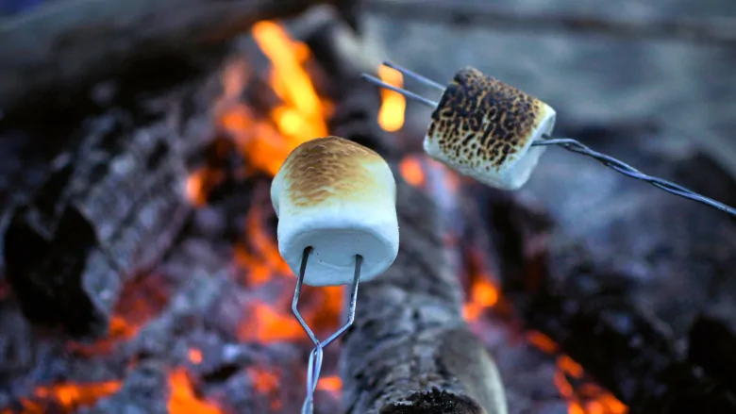
Skill Development/Guided Practice
Reminder: Thermal Energy Transfer Methods
Conduction – Energy transfer between two objects are in direct contact Convection – Energy transfer through movement of particles in liquids and gases Radiation – Energy transfer through space or other substances without it being heated
Describing Methods of Thermal Energy Transfer
Identify the type of energy transfer: Conduction/Convection/Radiation Explain why it is that type of energy transfer
Heat from the coals of a campfire cooks marshmallows.
The thermal energy is transferred ________________ through __________ because the energy is being transferred _______________________________.

Slide 20
Skill Development/Guided Practice
Reminder: Thermal Energy Transfer Methods
Conduction – Energy transfer between two objects are in direct contact Convection – Energy transfer through movement of particles in liquids and gases Radiation – Energy transfer through space or other substances without it being heated
Describing Methods of Thermal Energy Transfer
Identify the type of energy transfer: Conduction/Convection/Radiation Explain why it is that type of energy transfer
Heat moves up the metal fork used to toast your marshmallows.
The thermal energy is transferred ________________ through __________ because the energy is being transferred _______________________________.

Slide 21
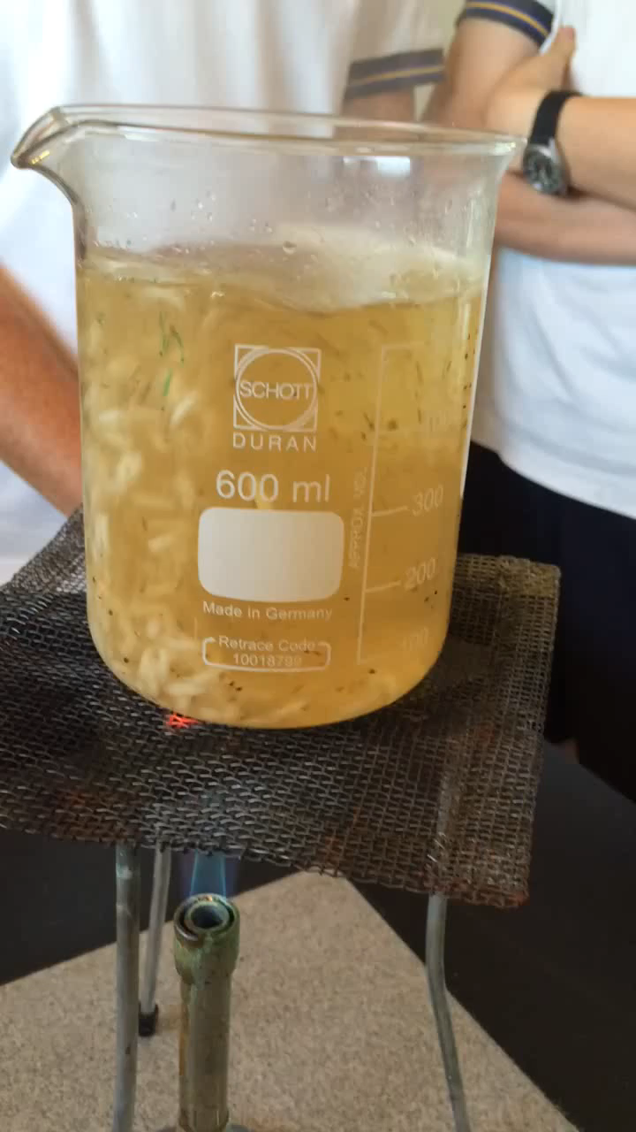
Skill Development/Guided Practice
Reminder: Thermal Energy Transfer Methods
Conduction – Energy transfer between two objects are in direct contact Convection – Energy transfer through movement of particles in liquids and gases Radiation – Energy transfer through space or other substances without it being heated
Describing Methods of Thermal Energy Transfer
Identify the type of energy transfer: Conduction/Convection/Radiation Explain why it is that type of energy transfer
Rice moves through water as it is heated and cooked.
The thermal energy is transferred ________________ through __________ because the energy is being transferred _______________________________.

Slide 22
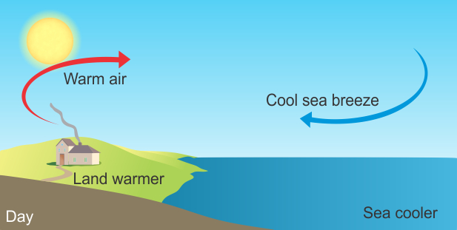
Relevance
Knowing how thermal energy is transferred through different methods will help you understand how thermal energy moves from one object to another.
More than one method of energy transfer can occur at the same time and can be used to explain natural phenomena, for example sea breezes.
The Sun transfers thermal energy to the land through radiation.
Thermal energy from the land is transferred to the air through conduction.
Convection currents cause warm air to rise and cool air from over the oceans to move onto the land.

Slide 23
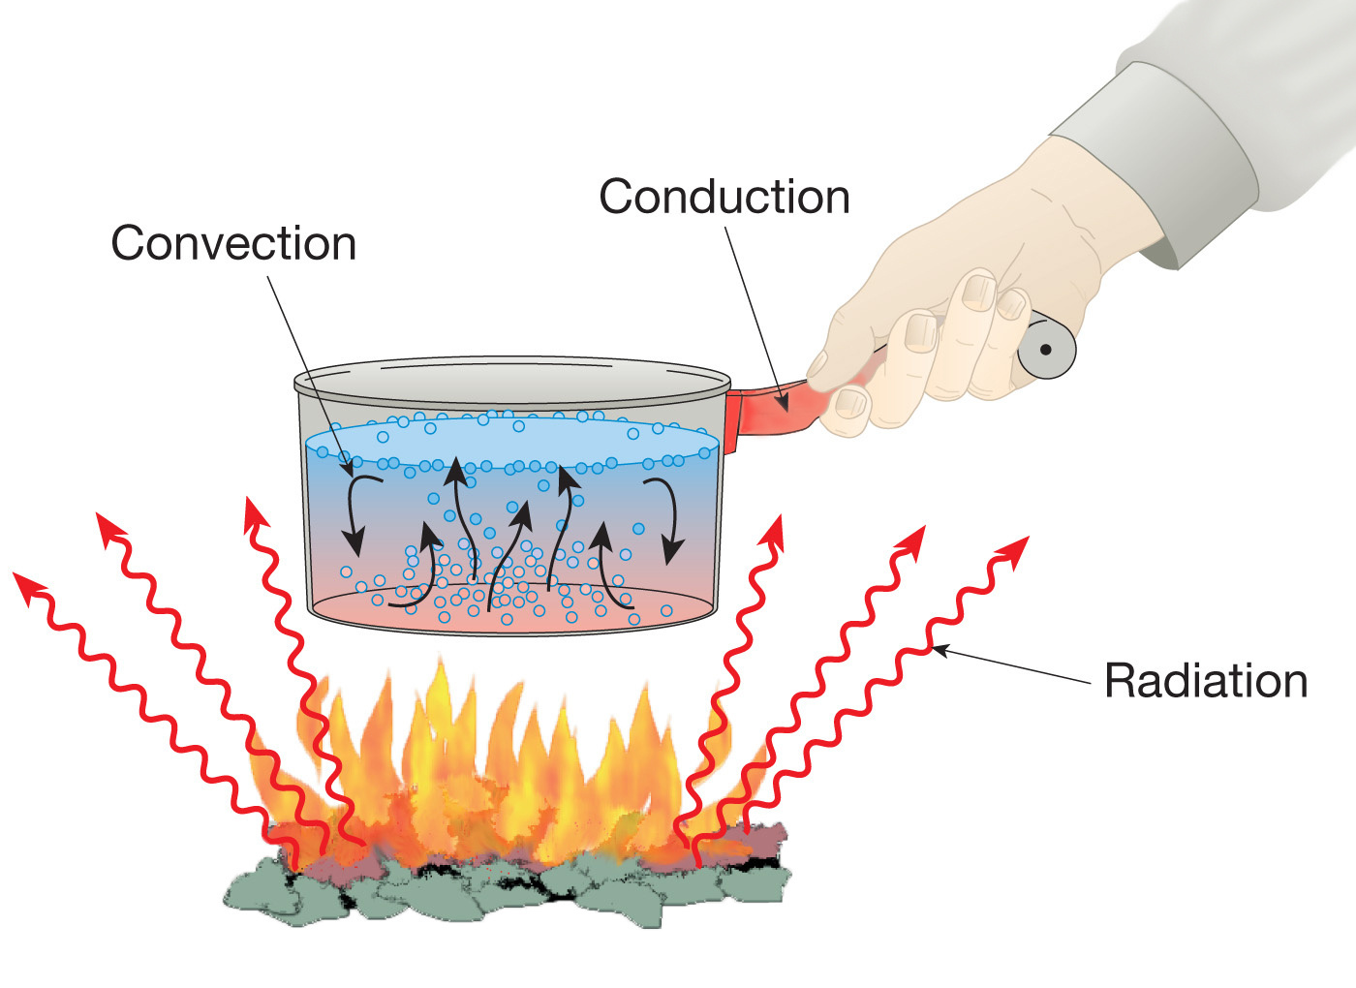
Skill Closure
2
Which way does thermal energy move?
1
Skill Closure
Match the method of energy transfer to its definition.
Energy transfer though movement of particles in a liquid or gas
Energy transfer through another substance without it being heated
Energy transfer between two objects in direct contact
3
Skill Closure
Identify the methods of energy transfer in the picture. Explain your choices.

Slide 24
Independent Practice
Complete the “Energy Transfer” worksheet on your device or on a paper copy.

